Slide 1
Computer Organization and Design Addressing Modes
Montek Singh
Feb 19, 2016
Lecture 6

Slide 2
Operands and Addressing Modes
Where is the data?
Addresses as data
Names and Values
Indirection

Slide 3
Please Review
Review the Lab 4 slide supplement:
Pointers, Arrays and Strings in C

Slide 4
Addressing Modes
What are all of the different ways to specify operands?
Operands = the variables needed to perform an instruction’s operation
Let us look more generally across various CPUs first, then focus on MIPS

Slide 5
Common “Addressing Modes” in various CPUs
MIPS can do these with appropriate choices for Reg and const
Absolute (Direct): lw $8, 0x1000($0)
Value = Mem[constant]
Use: accessing static data
Register-Indirect: lw $8, 0($9)
Value = Mem[Reg[x]]
Use: pointer accesses
Displacement: lw $8, 16($9)
Value = Mem[Reg[x] + constant]
Use: access to local variables
Indexed:
Value = Mem[Reg[x] + Reg[y]]
Use: array accesses (base+index)
Memory indirect:
Value = Mem[Mem[Reg[x]]]
Use: access thru pointer in mem
Autoincrement:
Value = Mem[Reg[x]]; Reg[x]++
Use: sequential pointer accesses
Autodecrement:
Value = Reg[X]--; Mem[Reg[x]]
Use: stack operations
Scaled:
Value = Mem[Reg[x] + c + d*Reg[y]]
Use: array accesses (base+index)
Is the complexity worth the cost?
Need a cost/benefit analysis!

Slide 6
Revisiting Operands in MIPS
Operands = the variables needed to perform an instruction’s operation
Three types in the MIPS ISA:
Register:
add $2, $3, $4 # operands are the “contents” of a register
Immediate:
addi $2,$2,1 # 2nd source operand is part of the instruction
Register-Indirect:
lw $2, 12($28) # source operand is in memory
sw $2, 12($28) # destination operand is memory
Simple enough, but is it enough?

Slide 7
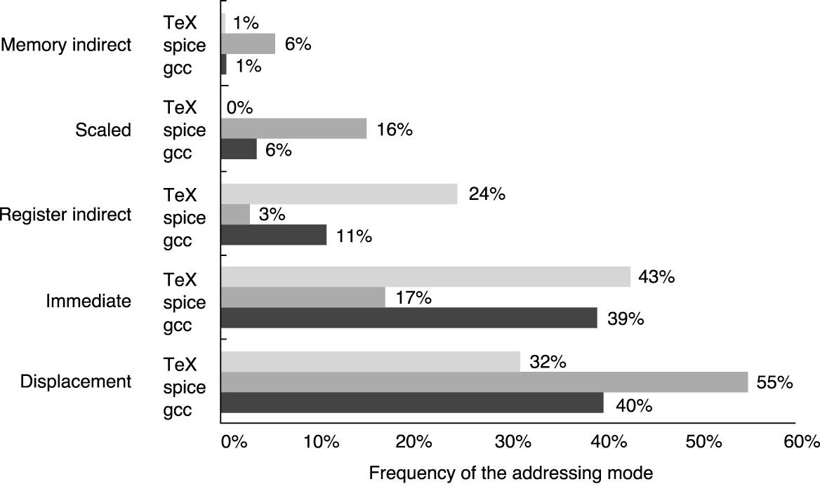
Relative popularity of address modes
Most common ones are
Displacement/Absolute (combined under “Displacement” in graph)
Register-Indirect
Immediate (i.e., constants within instructions)
From Hennessy & Patterson
(graduate architecture book)

Slide 8
Absolute (Direct) Addressing
What we want:
Contents of a specific memory location, i.e. at a given address
Example:
Caveat:
Sometimes generates a two instruction sequence
If the address for x chosen by the programmer/compiler/assembler is too large to fit within the 16-bit immediate field
“MIPS Assembly”
.data
x: .word 10
.text
main:
lw $2,x($0)
addi $2,$2,1
sw $2,x($0)
“C”
int x = 10;
main() {
x = x + 1;
}
Allocates space for a single integer (4-bytes) and initializes its value to 10
‘x’ here means address of x
lui $1,xhighbits
lw $2,xlowbits($1)
e.g., if x is at address 0x12345678
lui $1,0x1234
lw $2,0x5678($1)

Slide 9
Absolute (Direct) Addressing: More detail
“MIPS Assembly”
.data
x: .word 10
.text
main:
lw $2,x($0)
addi $2,$2,1
sw $2,x($0)
“After Compilation”
.data 0x0100
x: .word 10
.text
main:
lw $2,0x100($0)
addi $2,$2,1
sw $2,0x100($0)
“C”
int x = 10;
main() {
x = x + 1;
}
Assembler replaces “x” by its address
e.g., here the data part of the code (.data) starts at 0x100
x is the first variable, so starts at 0x100
this mode works in MIPS only if the address fits in 16 bits

Slide 10
Indirect Addressing
What we want:
The contents at a memory address held in a register
Examples:
Caveats
You must make sure that the register contains a valid address (double, word, or short aligned as required)
“la” is not a real instruction,
It’s a convenient pseudoinstruction that constructs a constant via either a 1 instruction or 2 instruction sequence
“MIPS Assembly”
.data
x: .word 10
.text
main:
la $2,x
addi $3,$0,2
sw $3,0($2)
ori $2,$0,x
“C”
int x = 10;
main() {
int *y = &x;
*y = 2;
}
lui $2,xhighbits
ori $2,$2,xlowbits
$2 performs the role of y, i.e., it is a pointer to x

Slide 11
Note on la pseudoinstruction
la is a pseudoinstruction: la $r, x
stands for “load the address of” variable x into register r
not an actual MIPS instruction
but broken down by the assembler into actual instructions
if address of x is small (fits within 16 bits), then a single ori
one could also use a single addiu
if address of x is larger, use the lui + ori combo
“MIPS Assembly”
.data
x: .word 10
.text
.global main
main:
la $2,x
addi $3,$0,2
sw $3,0($2)
0x0100
0x80000010
ori $2,$0,0x100
lui $2,0x8000
ori $2,$2,0x0010

Slide 12
Displacement Addressing
What we want:
contents of a memory location at an offset relative to a register
the address that is the sum of a constant and a register value
Examples:
Remember:
Must multiply (shift) the “index” to be properly aligned
“MIPS Assembly”
.data 0x0100
a: .space 20
.text
main:
addi $2,$0,3 // i in $2
addi $3,$0,2
sll $1,$2,2 // i*4 in $1
sw $3,a($1)
“C”
int a[5];
main() {
int i = 3;
a[i] = 2;
}
Allocates space for a 5 uninitialized integers (20-bytes)

Slide 13
Displacement Addressing: 2nd example
What we want:
The contents of a memory location at an offset relative to a register
Examples:
Note:
offsets to the various fields within a structure are constants known to the assembler/compiler
“MIPS Assembly”
.data
p: .space 8
.text
main:
la $1,p
addi $2,$0,13
sw $2,0($1)
addi $2,$0,12
sw $2,4($1)
“C”
struct p {
int x, y; }
main() {
p.x = 13;
p.y = 12;
}
Allocates space for 2 uninitialized integers (8-bytes)
Notes:
Calling p: . Space 8 says you are allocating 8 bytes, you do not know what the values are but you need the space.
What if you know the values?? You could say “p. word 40, 50” which would be saying structure p initialized to 40, 50
You could even put 0,0
Load address loads the address of p (8-bytes holds 2 ints) into register 1
At the end of la, register 1 will have the address of p
Register two has #13
sw (store word are important)
Stores number 13 in the first four bites of p
Beginning four bytes of $1 have 13
Second store word says use the beginning address of p, but move over 4 bytes an put the value of register 2 into it (which is 12)

Slide 14
Assembly Coding Templates
For common C program fragments

Slide 15
Conditionals: if-else
There are little tricks that come into play when compiling conditional code blocks. For instance, the statement:
if (y > 32) {
x = x + 1;
}
compiles to:
lw $24, y ori $15, $0, 32 slt $1, $15, $24 beq $1, $0, Lendif lw $24, x addi $24, $24, 1 sw $24, x
Lendif:
C code:
if (expr) { STUFF }
MIPS assembly:
(compute expr in $rx)
beq $rx, $0, Lendif
(compile STUFF)
Lendif:
C code:
if (expr) { STUFF1 } else { STUFF2 }
MIPS assembly:
(compute expr in $rx)
beq $rx, $0, Lelse
(compile STUFF1)
beq $0, $0, Lendif
Lelse:
(compile STUFF2)
Lendif:
Notes:
Use beq for if/else, branch if equal 0 is commonly used to describe things that are false
Beq 0, 0 is a pretty easy jump instruction to state an else
Load y into register 24
Ori 0 with 32 will give you 32
Register one set less than, given 1 if $15<$24
Register 1 is either true or false in example
Branches if register one is 0
If not you load x into register 24
Add 1 into register 24
And store $24 into x, saying… x=x+1

Slide 16
Loops: while
C code:
while (expr)
{ STUFF }
MIPS assembly:
Lwhile:
(compute expr in $rx)
beq $rX,$0,Lendw
(compile STUFF)
beq $0,$0,Lwhile
Lendw:
Alternate MIPS assembly:
beq $0,$0,Ltest
Lwhile: (compile STUFF)
Ltest:
(compute expr in $rx)
bne $rX,$0,Lwhile
Lendw:
Compilers spend a lot of time optimizing in and around loops
- moving all possible computations outside of loops
- unrolling loops to reduce branching overhead
- simplifying expressions that depend on “loop variables”
Notes:
Any time you see this while loop in c code, you can blindly use the expression in the middle.
On the right:
At the top your are gonna jump right into Ltest in the middle of the loop because 0 is always equal to 0
If the test is true, go into Lwhile… if it is not true you get out
The second while loop need fewer jumps to execute, because you check at the beggining get out or stay in the code..
One branch instruction to check whether you get out or stay in, or go back
There is only one branch in the loop, inside Ltest instead of Lwhile which has two branch instructions
In the first, you get to the bottom and then you check if you go out or go back

Slide 17
Loops: for
Most high-level languages provide loop constructs that establish and update an iteration variable, which is used to control the loop’s behavior
C code:
int sum = 0;
int data[10] = {1,2,3,4,5,6,7,8,9,10};
int i;
for (i=0; i<10; i++) { sum += data[i] }
MIPS assembly:
sum:
.word 0x0
data:
.word 0x1, 0x2, 0x3, 0x4, 0x5
.word 0x6, 0x7, 0x8, 0x9, 0xa
add $30,$0,$0
Lfor:
lw $24,sum($0)
sll $15,$30,2
lw $15,data($15)
addu $24,$24,$15
sw $24,sum
addi $30,$30,1
slti $24,$30,10
bne $24,$0,Lfor
Lendfor:

